Slide 1
Binary Search Tree Visualizer
Karel Bondan A. H. - 2440032373
Leon Jayakusuma - 2440032392
Nathanael Jason L. -2440047476

Slide 2
I
Problems

Slide 3
Problems
Difficulty understanding concepts of tree
Difficulty visualizing the “Tree algorithm”
01
02
In order to understand about tree data structures, it requires a deep understanding of pointers, structures, and recursion
Every tree’s dynamics rely heavily on recursion and understanding recursion will take some time
Visualizing a binary tree could be quite challenging, especially when it contain lots of child nodes.
It takes quite some time for people to understand the tree algorithm

Slide 4
THIS LEADS TO...
People loses interest in studying Data Structures & Algorithm

Slide 5
II
SOLUTION

Slide 6
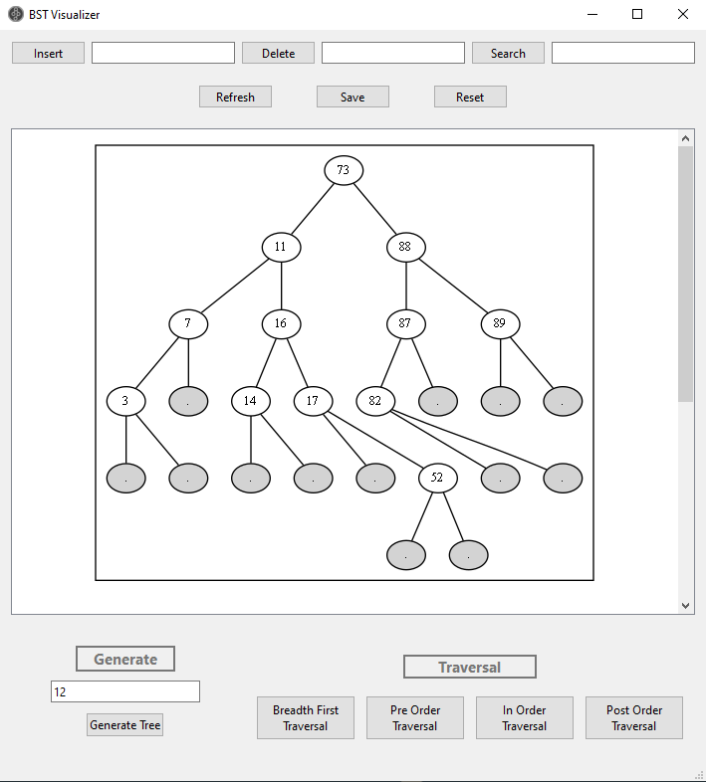
Binary Search Tree Visualizer
The reason of why we are using the Binary Tree data structure is because we want to visualize the tree and the algorithm process, easing users to understand more about Binary Tree; in this case, Binary Search Tree. It is the most natural data structure to be used in this case.
IMAGE SNEAK PEEK BST VISUALIZER HERE

Slide 7
The Features
Able to insert node manually
Able to visualize insertion, deletion, search algorithm from binary search tree
Able to generate random “Binary Search Tree” of size n

Slide 8
Algorithms implemented
Binary search tree algorithms (insert, delete, search)
Traversal algorithms:
Depth-First Traversal: In-order, pre-order, post-order
Breadth-First Traversal

Slide 9
Use Case Diagram
*Due to some limitations, we decided to change some few things

Slide 10
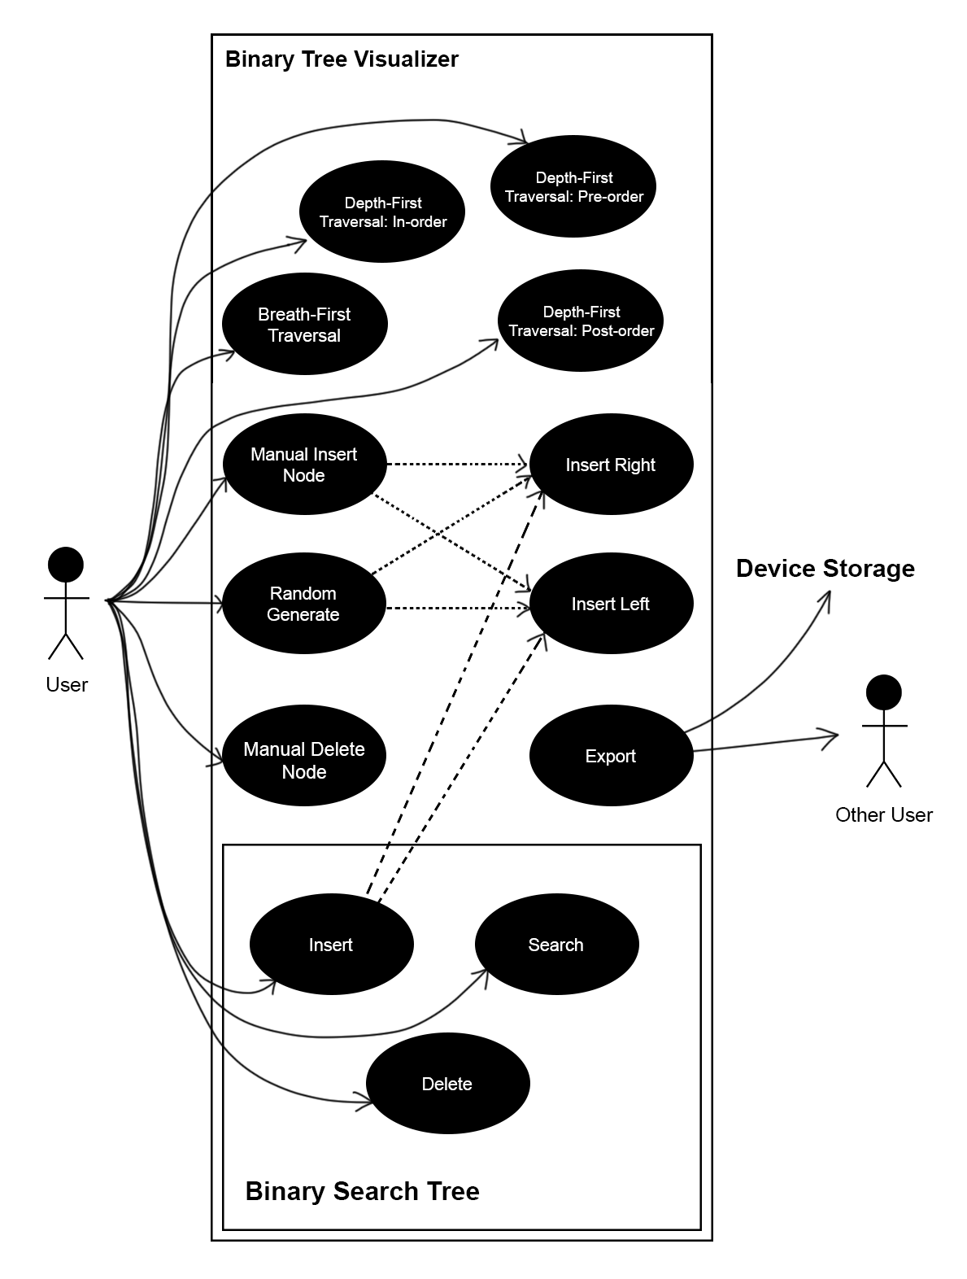
Initial Use Case Diagram

Slide 11
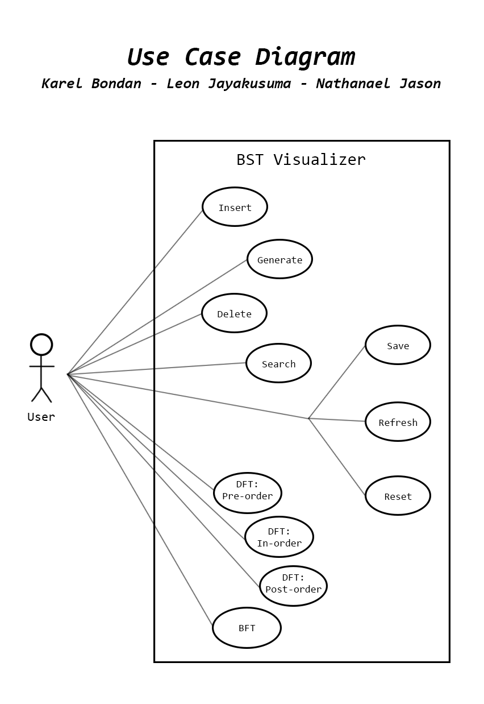
Final Use Case Diagram

Slide 12
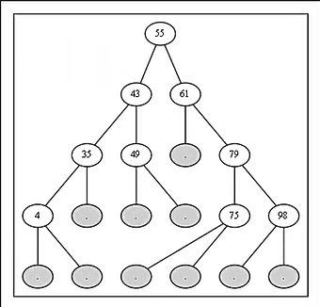
Result of Execution:
*This is an example of a randomized generated BST. Other execution results will be demonstrated later

Slide 13
DEMO

Slide 14
Achievements
We are able to visualize the binary search tree as expected,
We are able to animate the process of searching, insert, and delete of an element in a binary search tree,
Other than animating the insert, search, and delete, we were able to animate the traversal algorithms as well,

Slide 15
Difficulties
Difficult to use GraphViz library
So much new things to learn for creating user interfaces:
QTCreator User Interface
QT Library
GraphViz library
Connecting the classes dependencies
Tinkering with the binary search tree algorithms such that it allows not only doing the algorithm but also doing the animation along the way.

Slide 16
Future Works
Ms. Sera said that she would like to use our app to demonstrate how BST works in future lessons. If this really going to happen, we are going to try our best to optimize this program and try to get rid of all bugs. For the final project report, we are going to compare the algorithms in terms of their big O notations.

Slide 17

Link to Github
https://github.com/karelbondan/QT_BST_Visualizer

Slide 18
Thanks for listening!
Do you have any questions??

